Slide 1
DELP 2022
Final Project DMIT
Submitted By Deepali Ahuja

Slide 2
Part 1: Business Presentation

Slide 3
Business questions
How many users have joined Yelp each year since 2010?
How many users were elite in each of the 10 years from 2012 through 2021? Does it look like the number of elite users is increasing, decreasing, or staying about the same?
Which of our users has the most 5-star reviews of all time? Give us the person’s name, when they joined Yelp, how many fans they have, how many funny, useful, and cool ratings they’ve gotten. Please also gives us 3-5 examples of recent 5-star reviews they have written.
We’d like to talk with users who have lots of friends on Yelp to better understand how they use the social features of our site. Can you give us user id and name of the 10 users with the most friends?
Which US states have the most businesses in our database? Give us the top 10 states.
What are our top ten business categories? In other words, which 10 categories have the most businesses assigned to them?
What is the average rating of the businesses in each of those top ten categories?
We’re wondering what makes users tag a Restaurant review as “funny”. Can you give us 5 examples of the funniest Restaurant reviews and 5 examples of the 10 least funny? We’d also like you to look at a larger set of funny and unfunny reviews and tell us if you see any patterns that separate the two. (We know the last part is qualitative but tell us anything you see that may be useful.)
We think the compliments that tips receive are mostly based on how long the tip is. Can you compare the average length of the tip text for the 100 most-complimented tips with the average length of the 100 least-complimented tips and tell us if that seems to be true? (Hint: you will need to use computed properties to answer this question).
We are trying to figure out whether restaurant reviews are driven mostly by price range, how many hours the restaurant is open, or the days they are open. Can you please give us a spreadsheet with the data we need to answer that question? (Note from Professor Augustyn: You don’t actually have to hand in a spreadsheet…just give me a table with 10 rows of sample data returned by your query.)

Slide 4
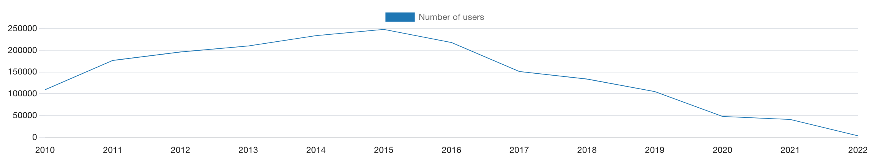
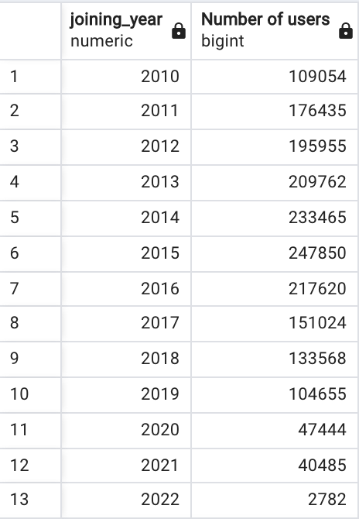
Users joined since 2010
1
There was an increase in the number of users from 2010 and is maximum in year 2015, since 2015 number of users are decreasing drastically.

Slide 5
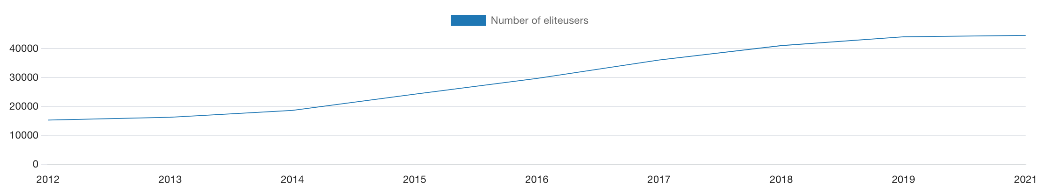
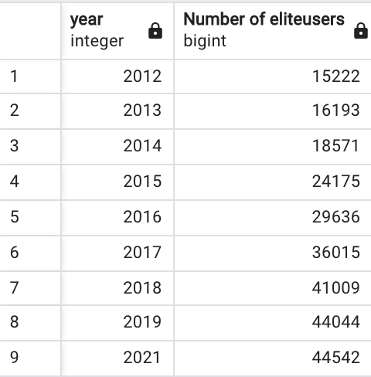

Elite users from 2012 through 2021
2
There is an increase in the number of elite users every year.

Slide 6
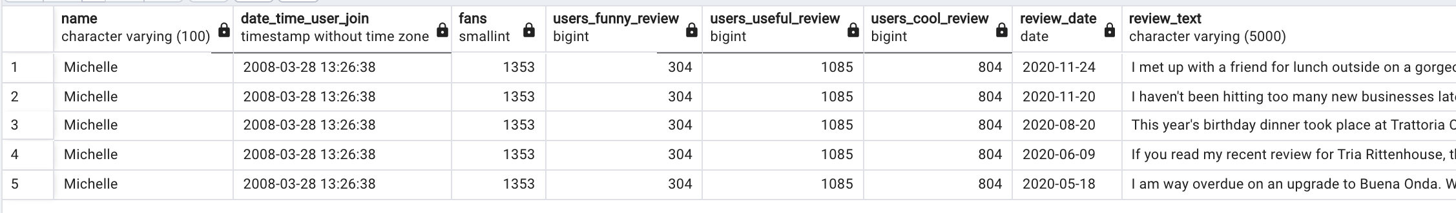
Users with most 5-star reviews of all time
3

Slide 7
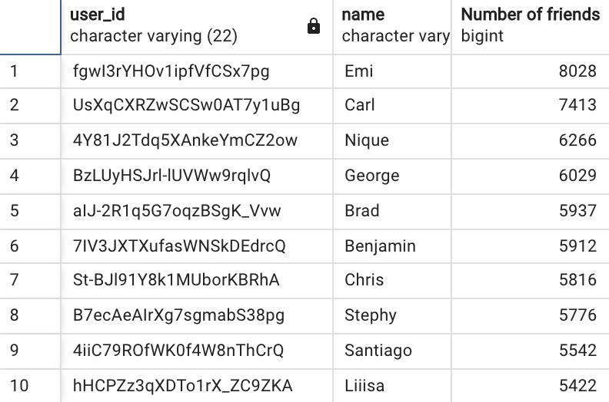
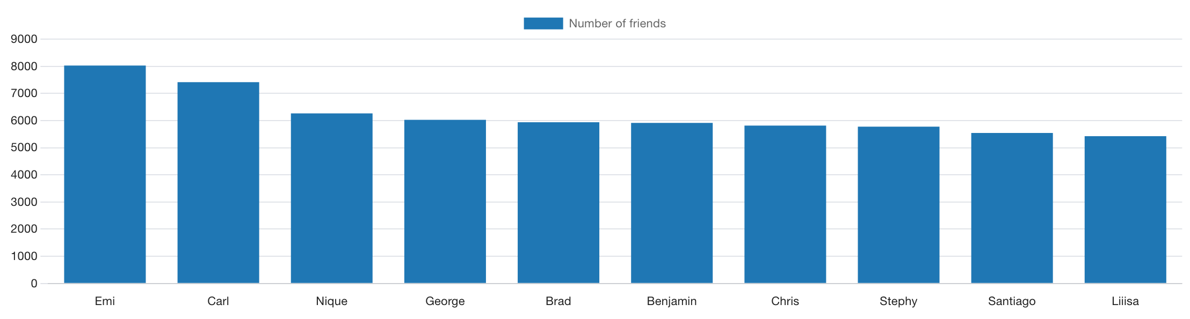
Users with most friends
4

Slide 8
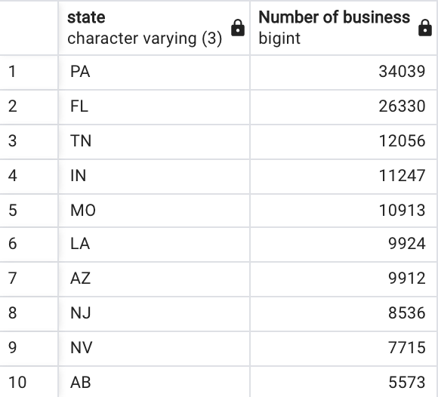
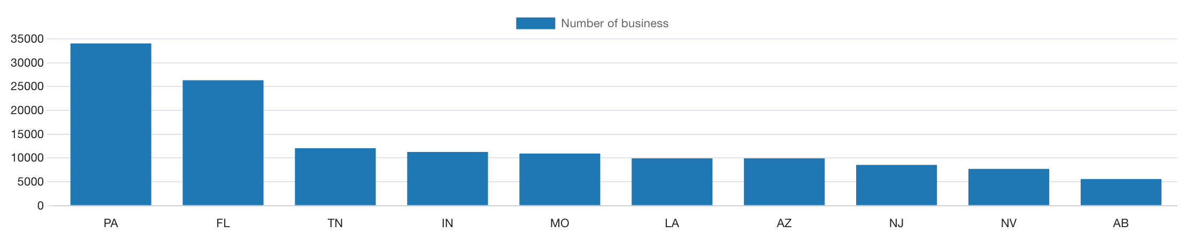
Top 10 US states with most businesses in DELP
5

Slide 9
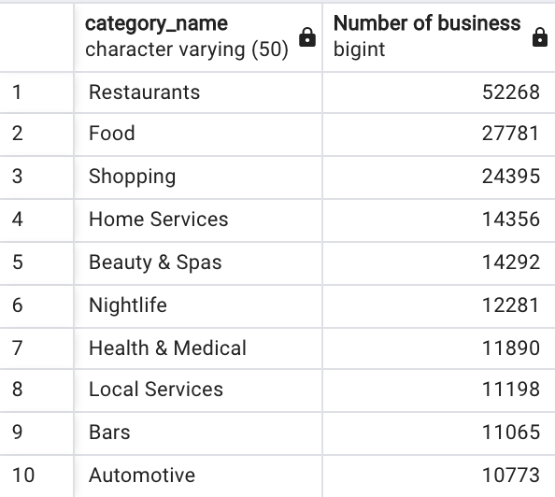
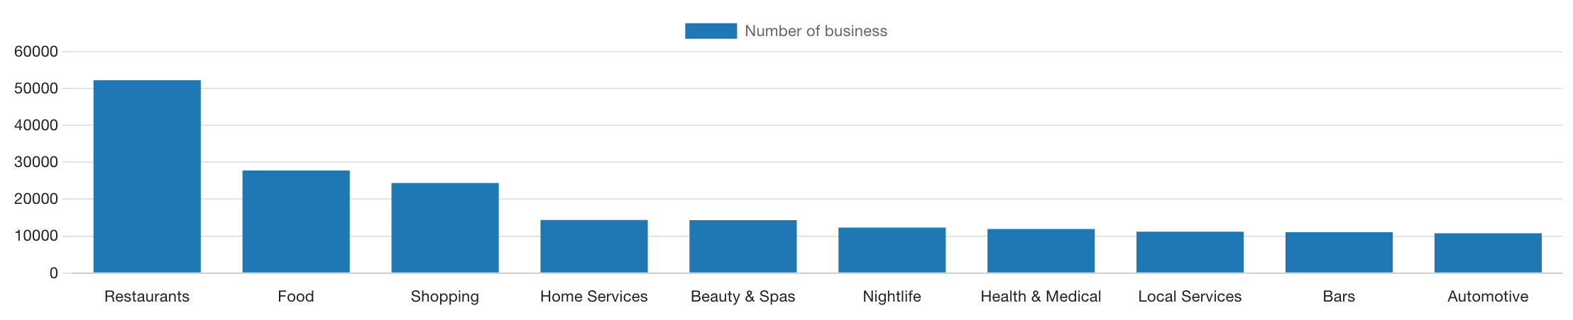
Top 10 business categories in DELP
6

Slide 10
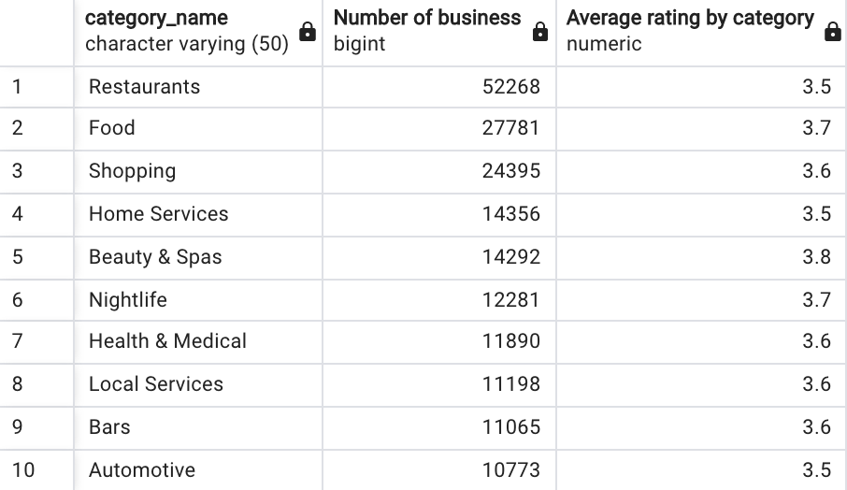
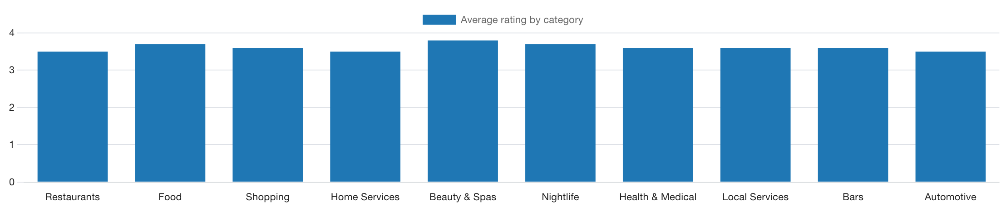
Average rating of top ten business categories in DELP
7

Slide 11
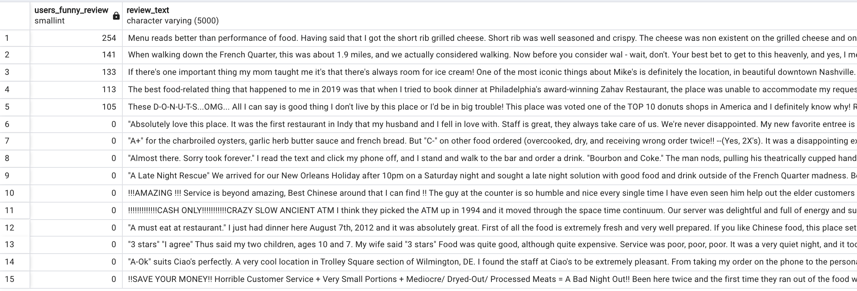
5 funniest Restaurant reviews and 10 least funny
8a

Slide 12
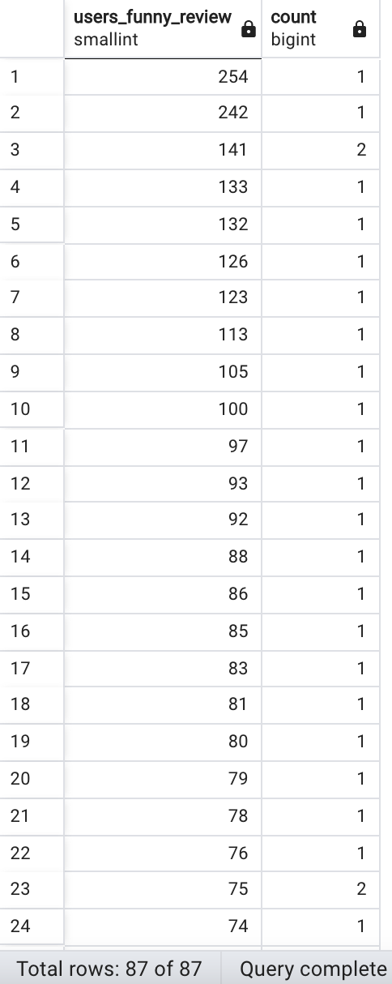
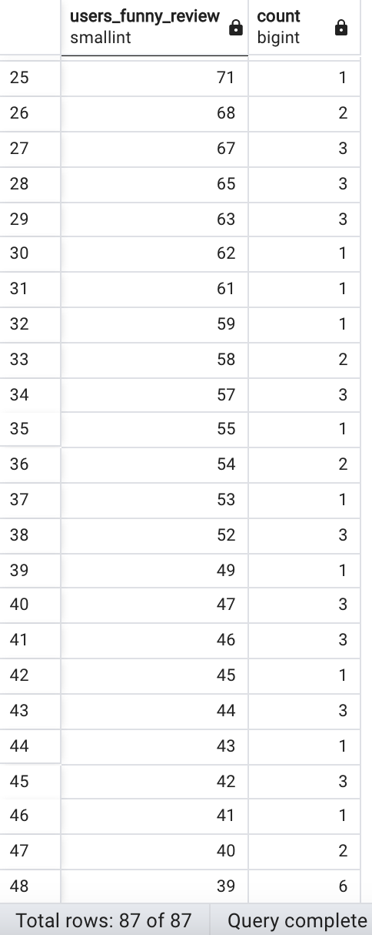
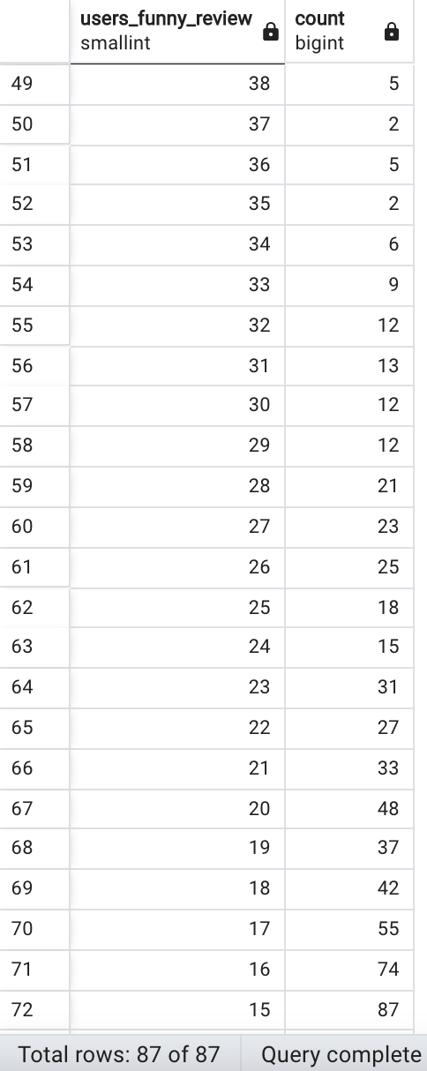
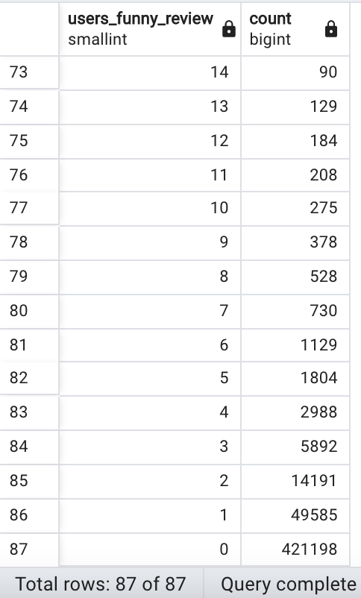
The pattern between funny and unfunny reviews
8b
Pattern Analysis: Using the above query we observed that there are only 2 reviews that have received the most funny votes (more than 250) whereas 498698 reviews (99.73 % out of total reviews) have received the least funny votes (less than 10)

Slide 13
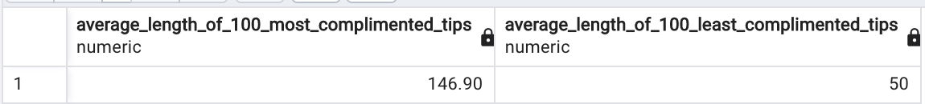
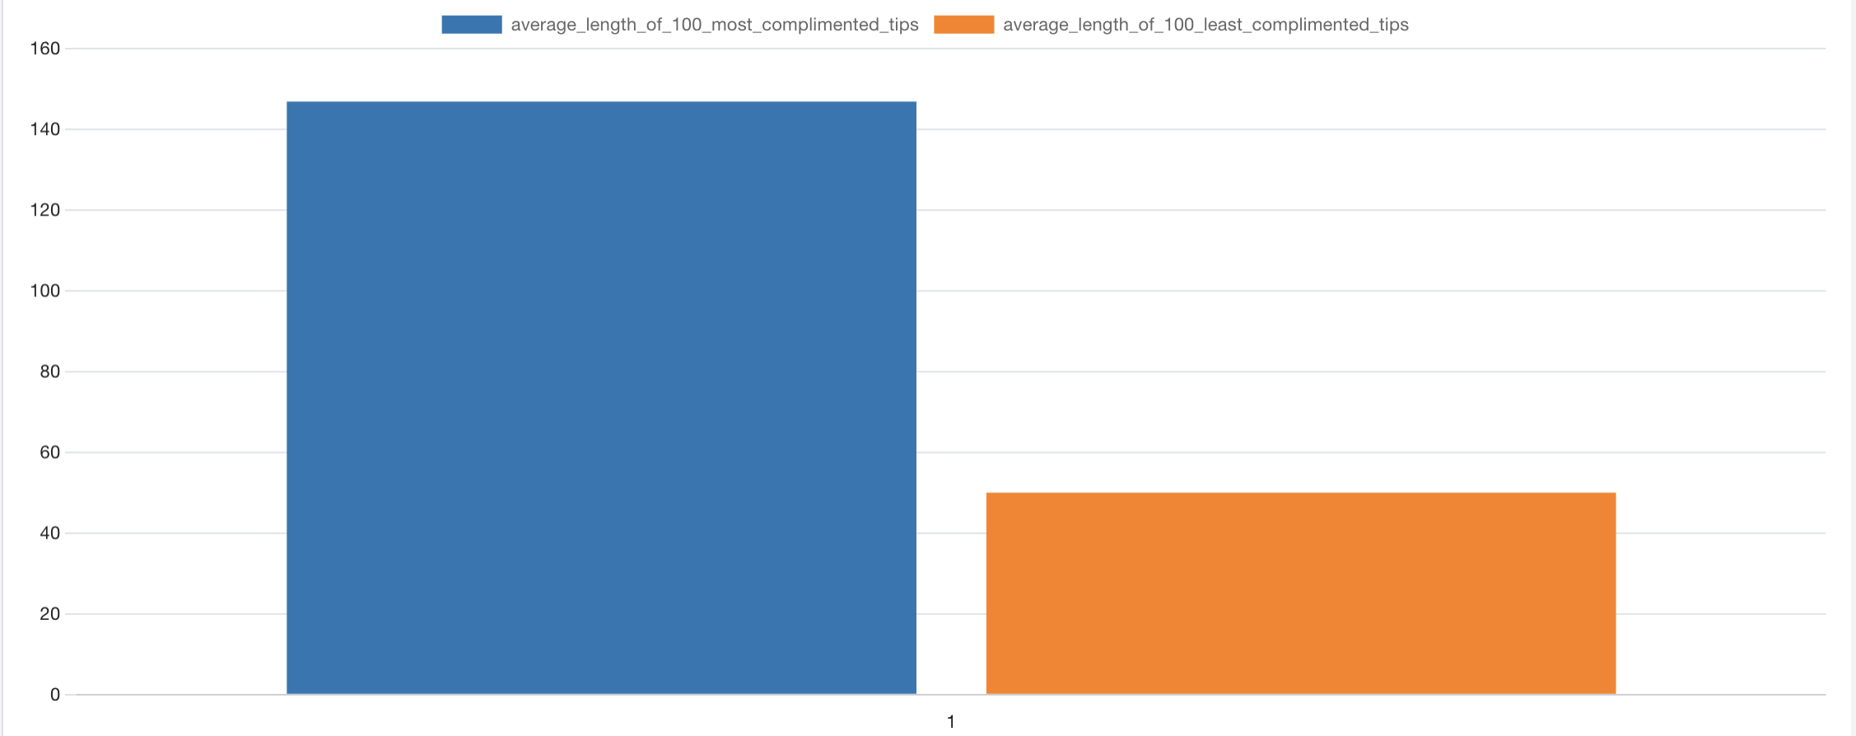
Comparison between the average length of the tip text for the 100 most v/s least-complimented tips
9
No, it's not true. Based on the query results, the average text length of 100 most complimented tips is 146.9, whereas for least 100 is 50. The overall difference is not significant.

Slide 14
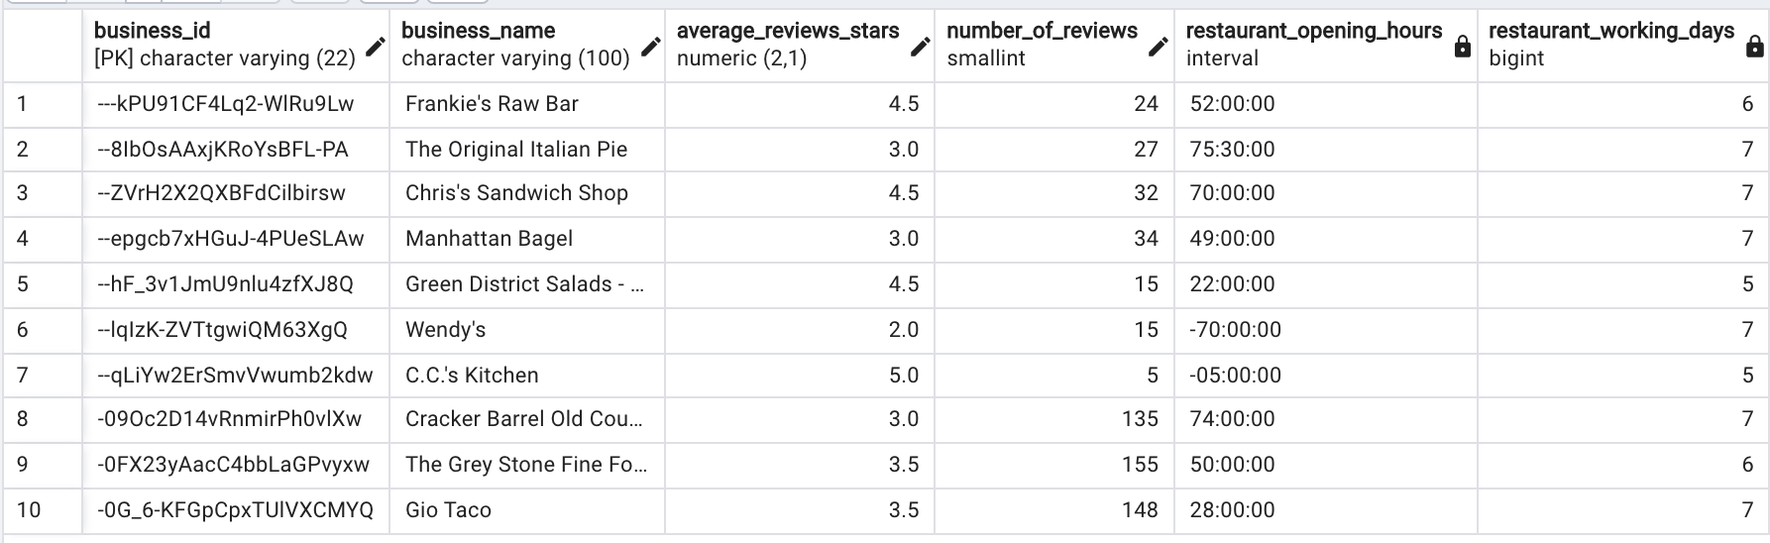
Impact on restaurant reviews by how many hours the restaurant is open, or the days they are open
10
No, restaurant reviews are not driven by how many hours the restaurant is open, or the days they are open as restaurant open for 28 hours received 148 reviews whereas a restaurant opened for more than 75 hours received only 27 reviews

Slide 15
This is a very rich dataset that can be used to answer many interesting questions.
For up to 10 points of extra credit, make up some of your own queries, answering other questions you think are interesting.
You will receive up to 2 points of extra credit for each original query you create. Simple queries (involving just one table) will be worth 1 point, more complex queries involving multiple tables will be worth 2 points.
Make a new slide for each original query, formatted the same as the ones answering the main business questions.
Extra credit

Slide 16
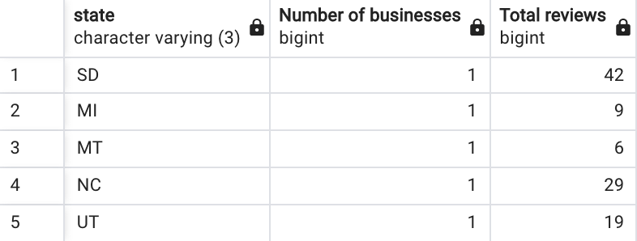
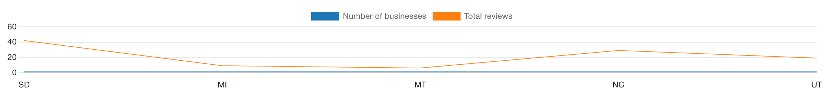
US States where businesses is need to be improved and their respective reviews

Slide 17
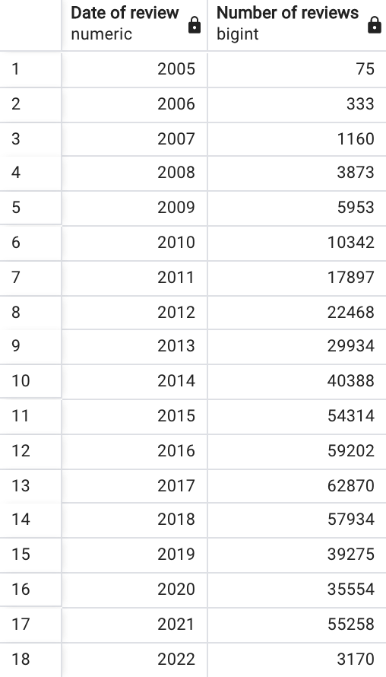
Reviews each year since 2000

Slide 18
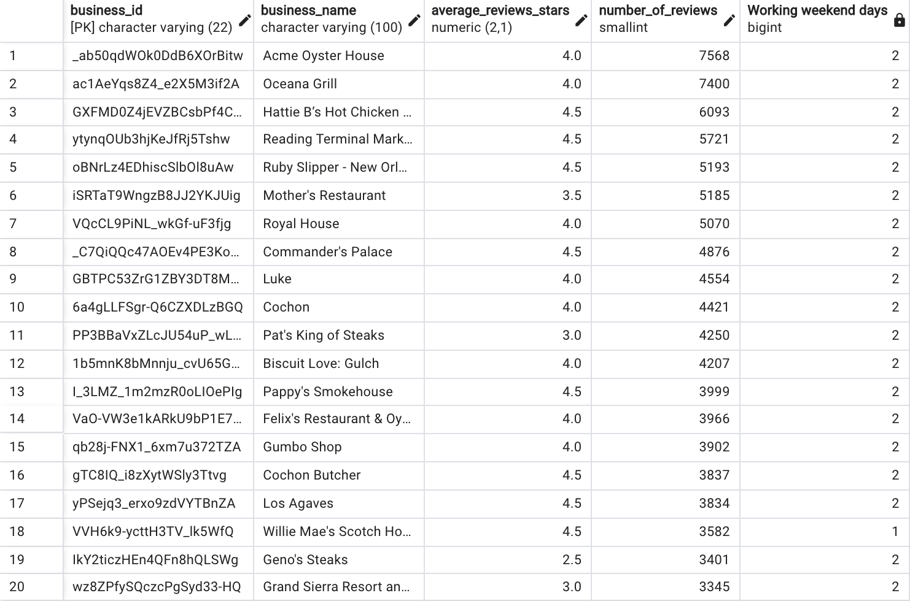
Is a business review affected by the fact they are open on weekends (Saturday and Sunday)
YES, the businesses open on weekends have more reviews comparatively.

Slide 19
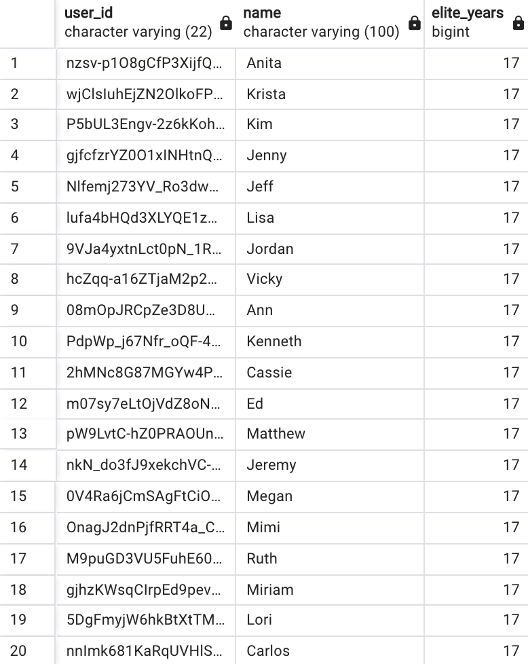
List of users that are elite for 10 or more years
There are total 4993 records

Slide 20
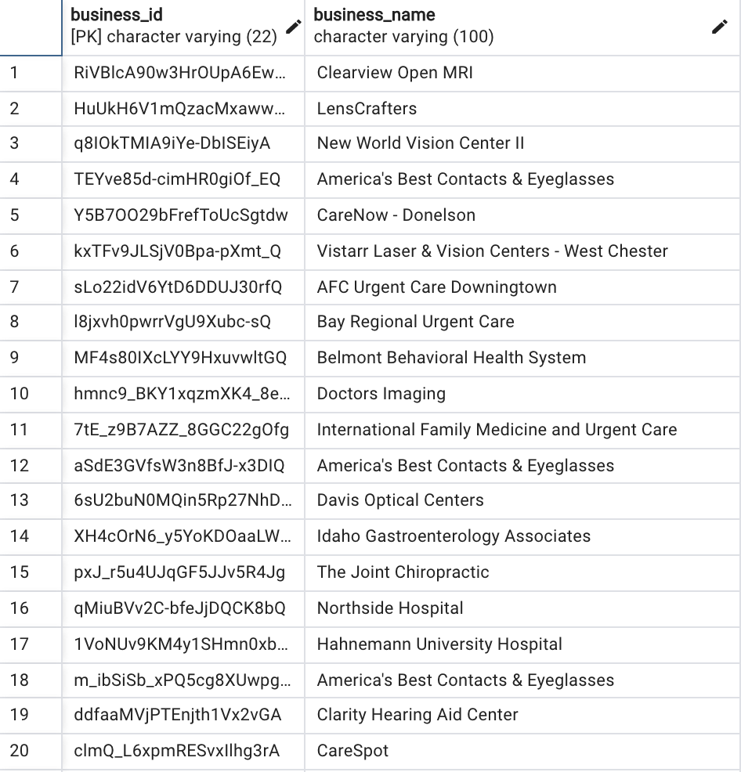
Are there any doctors that provide walk-ins on Monday
YES, there are total 789 records

Slide 21
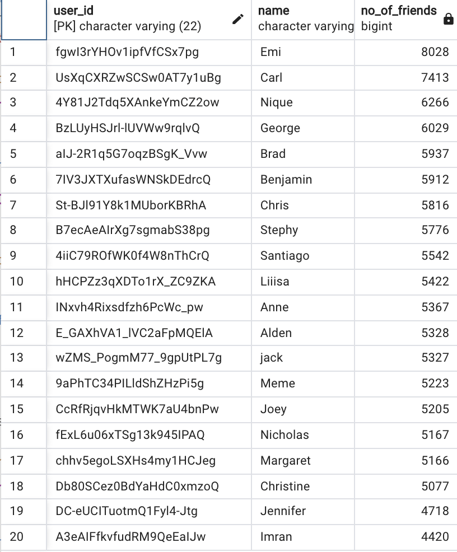
List down top 20 users with max friends

Slide 22
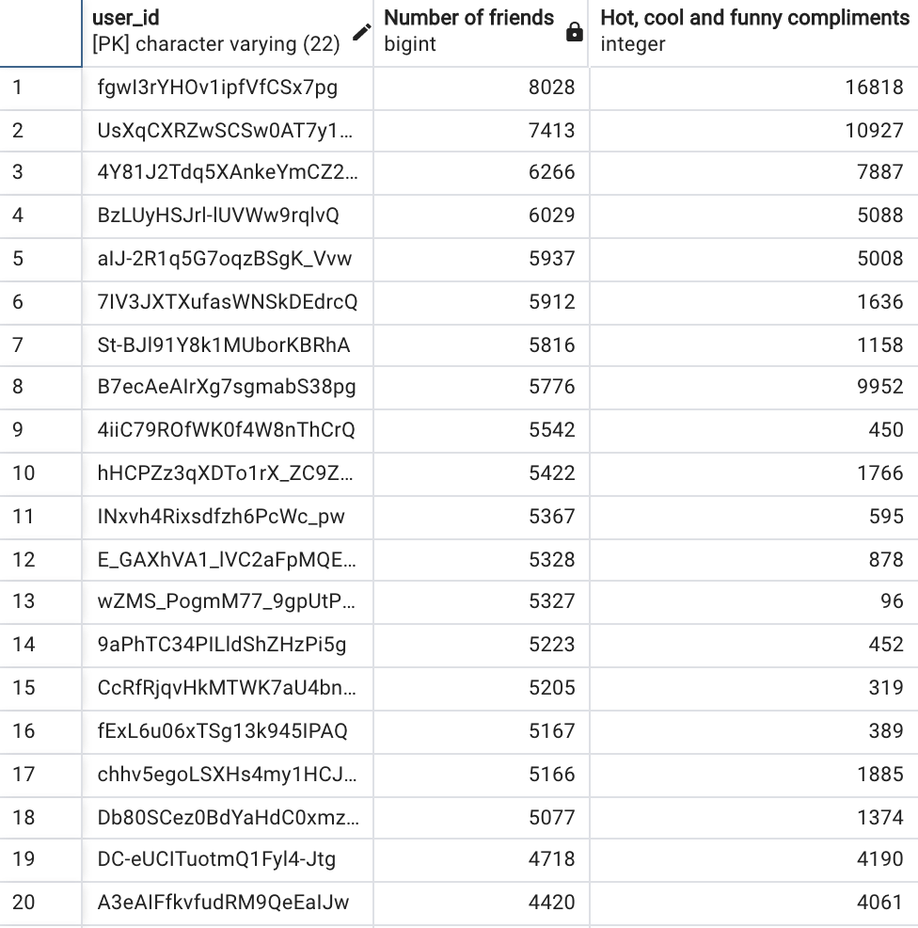
Is there a relation between number of friends and hot, cool and funny compliments received
NO, there is no relation

Slide 23
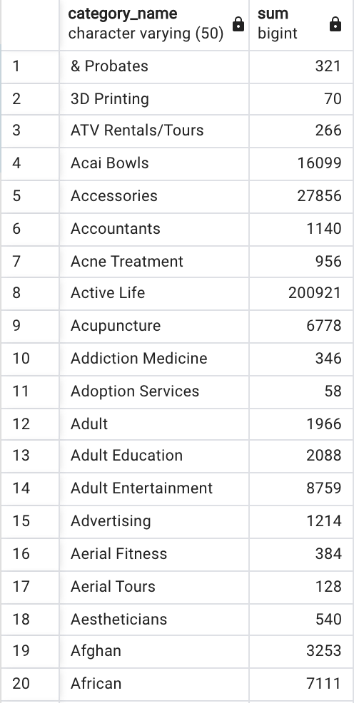
List the number of reviews by each business category

Slide 24
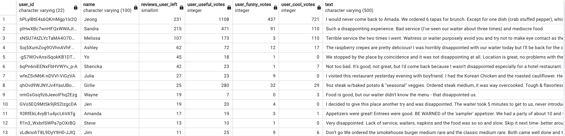
Disappointed customer about waiters in their tips

Slide 25
Part 2: Personal Presentation

Slide 26
What was your biggest challenge in working with this data? How did you overcome it?
What was the easiest part of the project for you (downloading the data from Moodle doesn’t count!)? What made it easy?
Was there anything that surprised you about the data?
Is there anything you wonder about how Yelp’s real data might look, how their database systems are designed, or what they do with this kind of data?
Are there any changes you would recommend to Yelp to make this data easier to work with?
Personal experience

Slide 27
Biggest challenge in working with DELP data and how I overcome it?
Major 2 challenges:
1. Initially, finding the right data types.
2. While doing queries 8, 9, and 10 in SQL.
I overcome this by making mistakes, analyzing and understanding, and thereby rewriting.

Slide 28
Easiest part of the project and what made it easy?
Creating tables and inserting values.
Creating ERD.
Creating Data Dictionary
These I find the easiest to work on as I have already worked on the “north-wind” database and I would say the way Professor Jason taught, it made easy.

Slide 29
Surprise about the data!
The data was so huge that excel does not support it well. When I tried to open the CSV in excel, it showed # values and NULL values for many columns and showed a message that some data is lost.

Slide 30
Look of Yelp data, design of their database systems, and its use
Yelp is a review site having real data that is very huge and yelp uses this data to provide valuable business insights and customer feedback to businesses. Yelp has used MySQL.
It is used by local to improve their business and by customers to get benefits from other’s reviews.

Slide 31
Recommended changes to Yelp to make this data easier to work with
Reviews are somewhat misleading, as there are so many options from which they are evaluated. There should be options like filter by friends
And only useful reviews should be used to calculate the star rating.

